Slide 1
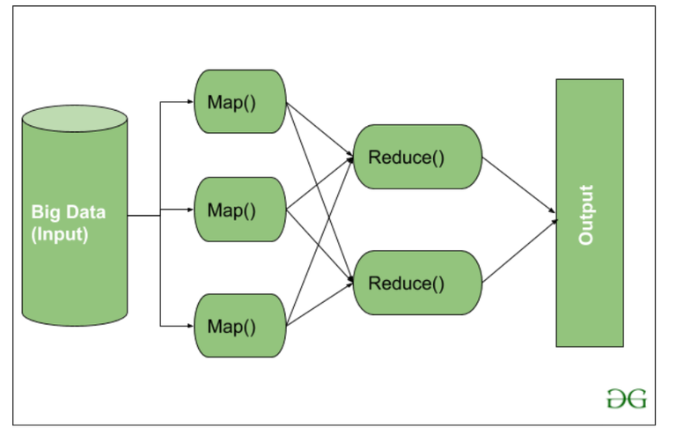

Introduction to Hadoop MapReduce Framework
Hadoop MapReduce is a programming framework for processing large data sets in a distributed computing environment. It provides a scalable and fault-tolerant solution for analyzing big data. MapReduce divides the processing into two tasks: the Map task for processing input data and the Reduce task for summarizing the results. This framework is a core component of Apache Hadoop, designed to handle massive amounts of data efficiently.
by Dr. D. J. Nagendra Kumar

Slide 2
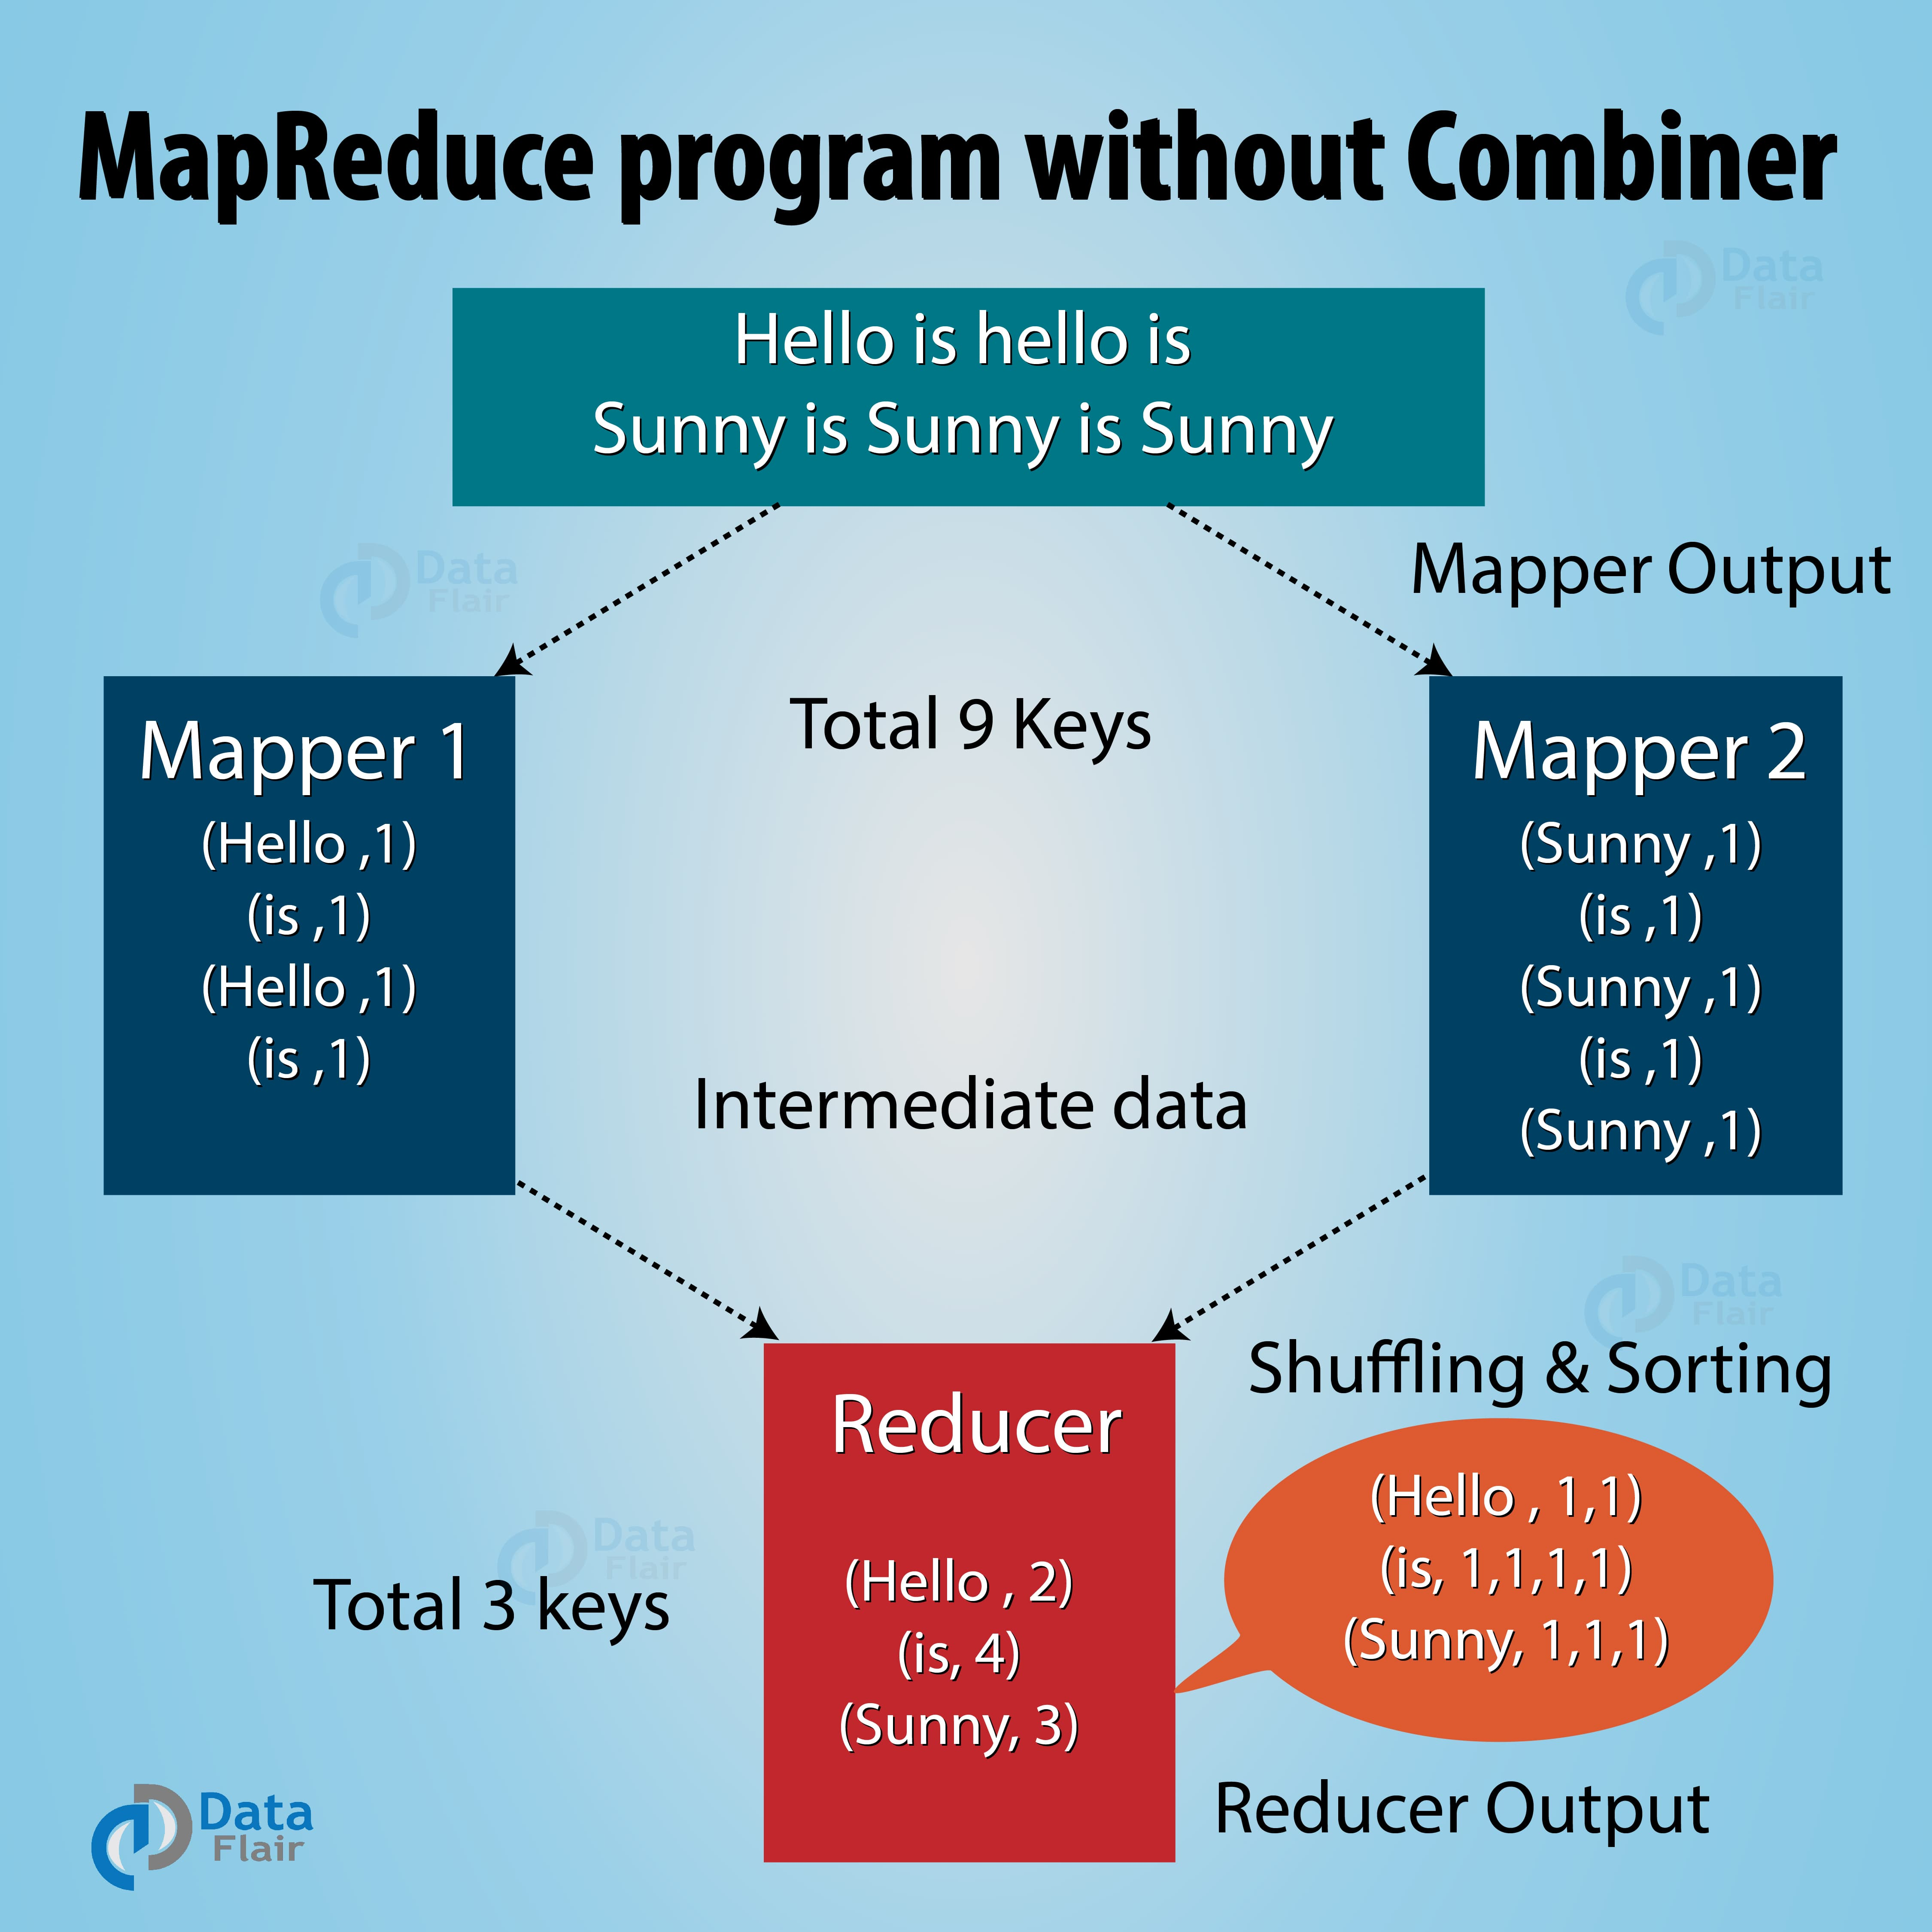
Overview of Mapper and Reducer Functions
Mapper Function
The Mapper function in Hadoop MapReduce is responsible for processing the input data, transforming it into key-value pairs, and emitting intermediate key-value pairs for the Reducer function to process. It plays a crucial role in data preprocessing and mapping the input into intermediate data for the Reducer to act upon.
Reducer Function
The Reducer function in Hadoop MapReduce receives the outputs from the Mapper, groups and processes them, and produces the final output. It performs aggregation and summarization of the intermediate key-value pairs. The Reducer function is vital for consolidating and deriving meaningful insights from the processed data.

Slide 3
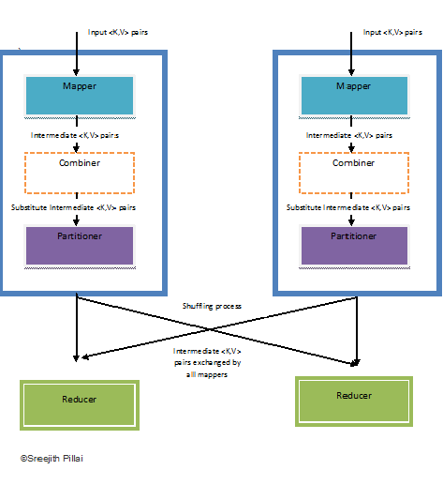
Explanation of Combiner and Its Role in MapReduce
Optimizing Data Transfer
Improving Performance
The Combiner in Hadoop MapReduce is used to optimize data transfer between the Mapper and Reducer functions. It acts as a mini-reducer by processing the intermediate key-value pairs locally on the map nodes. This reduces the volume of data transmitted to the reducers, enhancing the overall efficiency of the MapReduce job.
By reducing the amount of data that needs to be transferred across the network, the Combiner improves the performance of MapReduce tasks. It helps in minimizing network congestion and enhances the speed of data processing, especially for operations involving a large volume of data.

Slide 4
Understanding Partitioner and Its Significance
1
Data Distribution
2
Custom Data Placement
The Partitioner in Hadoop MapReduce ensures that the intermediate key-value pairs from the Mapper are distributed across the Reducer tasks based on keys. It plays a crucial role in controlling the data distribution among the Reducer nodes, ensuring efficient utilization of computational resources.
Developers can implement custom partitioning logic to control how the data is distributed across Reducers. This allows for fine-grained control over the distribution of intermediate key-value pairs, optimizing the workload balance and improving the overall performance of the MapReduce job.

Slide 5
Step-by-Step Guide to Writing a Java MapReduce Program
Setting Up Development Environment
Defining Mapper and Reducer Classes
Incorporating Combiner and Partitioner
To begin writing a Java MapReduce program, set up the development environment by installing the required tools, such as Java Development Kit (JDK), Apache Maven, and an Integrated Development Environment (IDE) like IntelliJ IDEA or Eclipse.
Create the Mapper and Reducer classes by implementing the necessary interfaces and methods to define the mapping and reducing logic for processing the input data and producing the final output.
Integrate the Combiner and Partitioner into the program to optimize the data processing and enhance the efficiency of the MapReduce job, especially for large-scale data processing tasks.

Slide 6




Setting Up the Development Environment
Install Java Development Kit (JDK)
Configure Apache Maven
Select Integrated Development Environment (IDE)
Download and install the latest version of JDK to set up the Java development environment.
Set up Apache Maven to manage the project's build, reporting, and documentation using the Project Object Model (POM).
Choose an IDE such as IntelliJ IDEA or Eclipse for a convenient and feature-rich development experience.

Slide 7
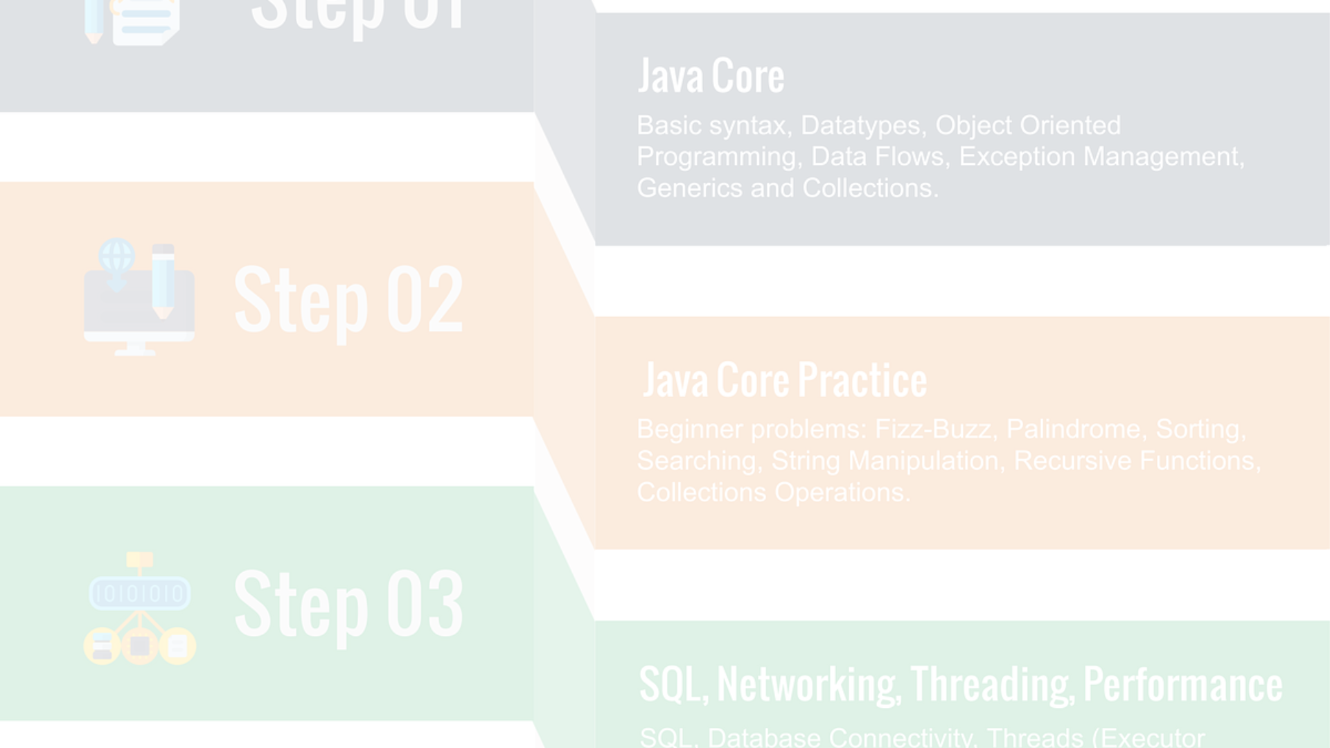
Defining the Mapper Class and Its Implementation
1
Input Data Processing
2
Key-Value Pair Transformation
In the Mapper class, implement the map method to process the input data and emit intermediate key-value pairs using the context object.
Define the logic for transforming the input data into key-value pairs that serve as the intermediate output for the Reducer function.

Slide 8

Implementing the Reducer Class and Its Functionality
1
Data Aggregation
The Reducer class aggregates and processes the intermediate key-value pairs generated by the Mapper, creating the final output for the MapReduce job.
2
Summarization
It performs summarization and consolidation of the intermediate results, producing meaningful insights from the processed data.
3
Output Generation
Generates the final output by combining the results of the Reducer function and presenting the desired analysis or computations.

Slide 9
Incorporating the Combiner and Partitioner in the Program
Combiner Integration
Custom Partitioner Development
Integrate the Combiner logic into the MapReduce program to optimize the data transfer and enhance performance by reducing network overhead.
Develop a custom Partitioner to control the distribution of intermediate data across Reducer nodes, balancing the workload efficiently.

Slide 10




Running and Testing the MapReduce Program
Building and Packaging
Submitting Job to Hadoop Cluster
Validation and Verification
Compile and package the MapReduce program into a deployable format such as a JAR file for execution on the Hadoop cluster.
Submit the MapReduce job to the Hadoop cluster using the Hadoop MapReduce framework, specifying the input and output directories, and required configurations.
Validate the results by examining the output data and verify the correctness and completeness of the MapReduce program's functionality.

